Slide 1
Product, R&D and Operation
Back to Basics
PuGong

Slide 2
Agenda
Why Software is Important
A Typical Software Team
Product Team: Who, What
Dev Team: Who, What
Ops Team: Who, What
How to be an successful team

Slide 3
Why software is important

Slide 4
Product team
Members
Product Owner
Product Manager
Assist Product Manager
Responsibility

Slide 5
Dev team
Members
Dev lead
Architect
Software Engineer
Responsibility

Slide 6
OPS team
Infrastructure OPS
Infrastructure Engineer
DBA
Helpdesk
Product OPS
Marketing OPS
Content OPS
User OPS
BD OPS

Slide 7
OPS team
Responsibility

Slide 9
为什么需要软件研发
Enable 业务
优化当前业务
自动化当前业务的某些流程
电子化当前业务

Slide 10
项目制
Project Manager
Sales
R&D

Slide 11
Sales打单（确定项目范围）
Project Manager 协调资源
Dev团队实施及Early Support
Support by Dev团队或专门的支持团队

Slide 12
产品型
Production
Operation
R&D

Slide 13
Product: 确定产品范围和功能迭代
Dev: 设计，实现以及三线支持
Operation: 线上产品运营，一线&二线支持
PRJ：根据预算，资源在一定时间内完成某些目标
OPS：运维，服务器／网络等

Slide 14
Product
Product Management is a strategic and business-oriented role, focused on delivering solutions to market needs.
Product Managers...
Identify profitable opportunities that meet market needs
Launch products into the market
Oversee products already in the market
Sunset products that longer meet market needs

Slide 15
R&D
Functions
技术可行性分析（ProtoType）
按照规划实施产品迭代
线上问题解决
Members: Professionals like Architect，Specialist，Dev，QA
NEED to know Tech Domain & Product Domain

Slide 16
运营
让产品运行的更好，运行的更久
市场运营：marketing
用户运营：UGC
内容运营：UGC／大牛
社区运营：活动
商务运营：BD／Sales

Slide 17
Product Delivery Team
产品：想出来
R&D：做出来
运营：用起来

Slide 18
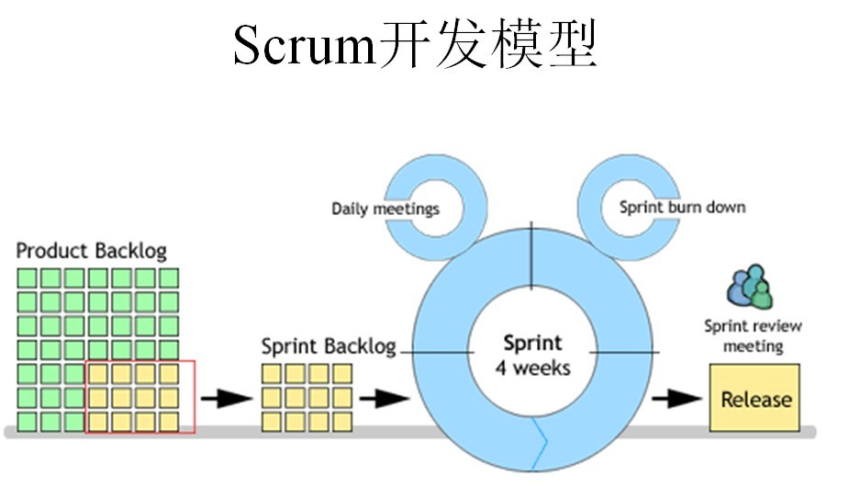

Slide 19
References
Product Manger: https://www.zhihu.com/topic/19551325/hot
Operation: https://www.zhihu.com/topic/19551958/hot
10x Engineer: https://shubhamjain.co/2015/01/19/hackers-are-the-real-10x-engineers/
Agile & Scrum
TDD, DDD etc

